Slide 1
APM30 TEMPERATURE SENSOR EXTENSION

Slide 2
Introduction
The APM30 has ability to sense battery temperature and use it in the execution of battery temperature compensation.
Currently all Apm30 rectifier systems have temperature sensors installed within the upper section of modules and are picking rectifier temperatures.
In this state, if we activate temperature compensation the system will be using that temperature to execute temperature compensation.
The right point to pick these temperature should be the batteries. So this document is meant to guide you through the process of extending the temperature sensor to the battery cabinet.

Slide 3
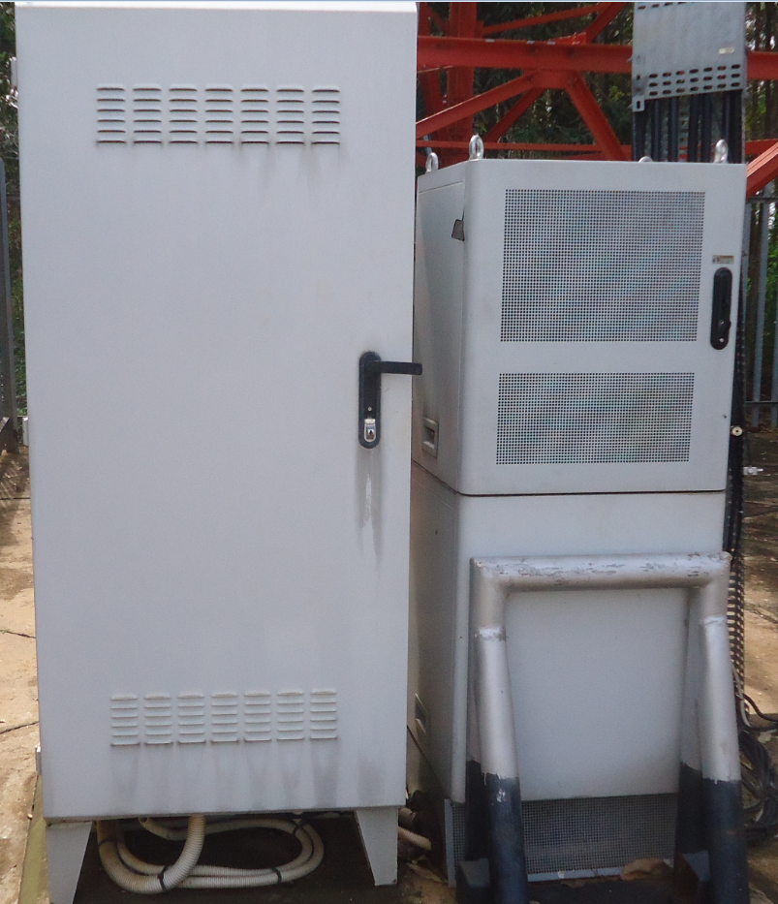
Site layout;
In all our sites the APM30 is installed just next to battery cabinet as below

Slide 4
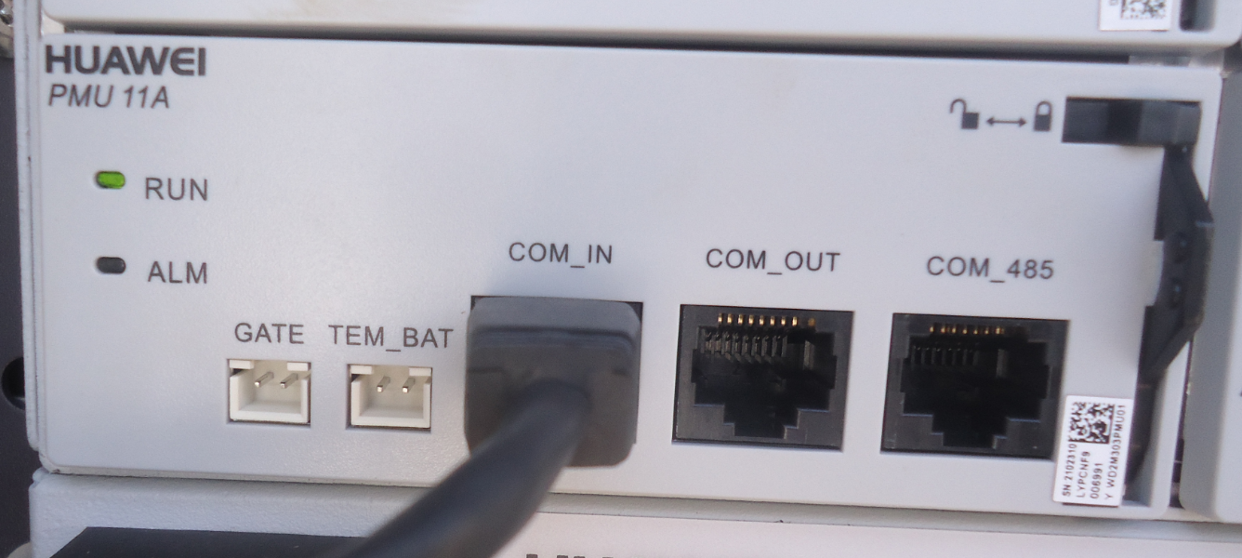
.
The sensor cable is too short to be extended from the PMU to the battery cabinet.
We shall have to cut the cable and then fix a long cable in between for the sensor to reach the battery cabinet.
At the PMU the cable should run from TEM_BAT to the sensor in the battery cabinet.

Slide 5
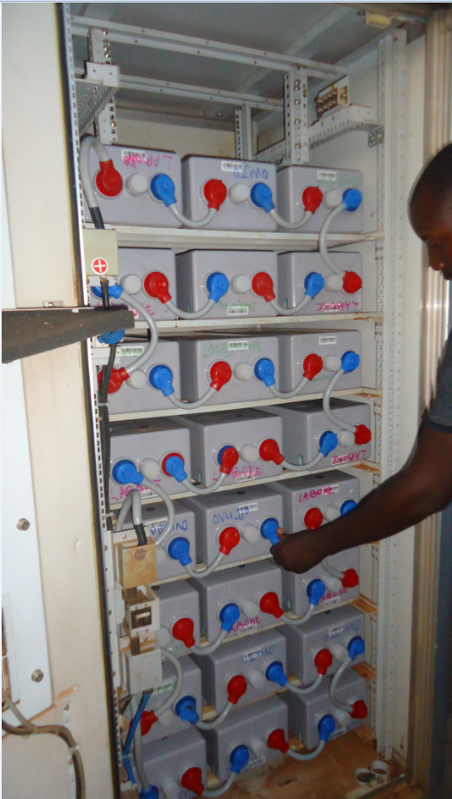
.
The sensor is the inserted between the battery.

